Slide 1
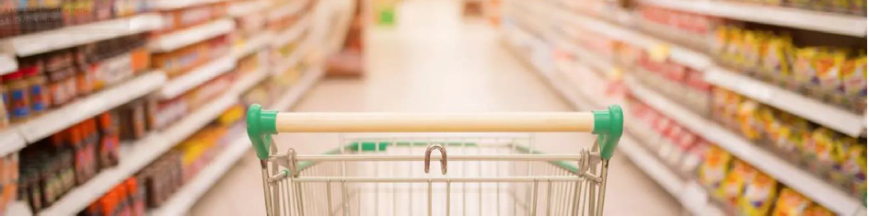

MARKET BASKET ANALYSIS OF GROCERY STORE DATA
(APRIORI ALGORITHM)
PRIYA DAVIS

Slide 2
FRAMEWORK:
PROBLEM STATEMENT
DATASET DESCRIPTION
EXPLORATARY DATA ANALYSIS
POST DATA PROCESSING & FEATURE SELECTION
MODEL DEVELOPMENT & EVALUATION
CONCLUSION

Slide 3
PROBLEM STATEMENT
One of the Grocery Store in the city has given their sales of Groceries data to find useful outcome.
Our Goal is to examine the transactional patterns of grocery purchases and discover both obvious and not-so-obvious patterns in certain transactions.
This may boost sales.

Slide 4
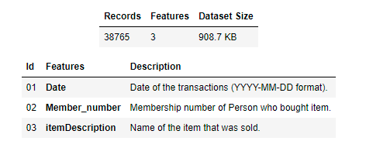
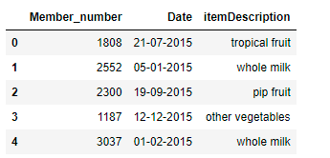
DATASET DESCRIPTION
The Groceries Market Basket dataset contains 38765 transactions by customers shopping for groceries.
The data is suitable to do data mining for market basket analysis which has multiple variables.
Groceries Data Set contains Date of transaction, Member number and Item Description.

Slide 5
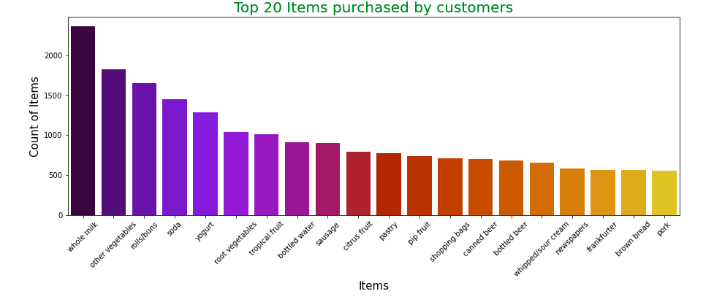
EXPLORATARY DATA ANALYSIS
Chart shows that whole milk is most purchased item followed by other Vegetables and roll/buns

Slide 6
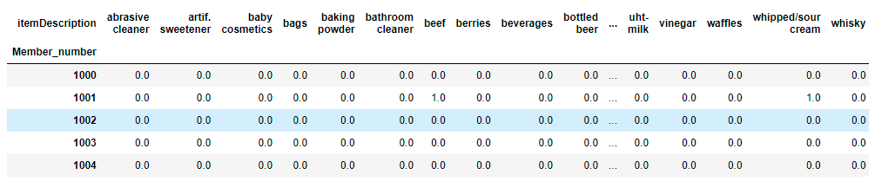
POST DATA PROCESSING
Data is transformed concerning the expected input by Apriori.
Each item inside the "Item" feature will become a feature and “Member_number" feature will become an index.

Slide 7
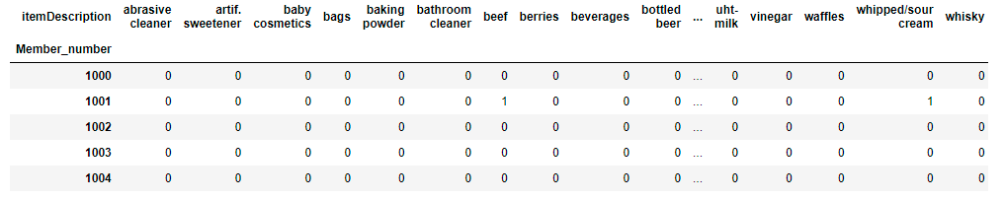
FEATURE SELECTION
Feature is encoded with binary data only. If any feature is found to have a value greater than one will be set to 1.

Slide 8
MODEL DEVELOPMENT & EVALUATION
Market Basket Analysis is an unsupervised machine learning technique that can be useful for finding patterns in transactional data.
It can be a very powerful tool for analyzing the purchasing patterns of consumers.
The main algorithm used in market basket analysis is the Apriori algorithm.
The three statistical measures in market basket analysis are Support, Confidence, and Lift.
Support: Measures the frequency an item appears in a given transactional data set.
Confidence: Measures the algorithm’s predictive power or accuracy.
Lift: Measures how much more likely an item is purchased relative to its typical purchase rate.

Slide 9
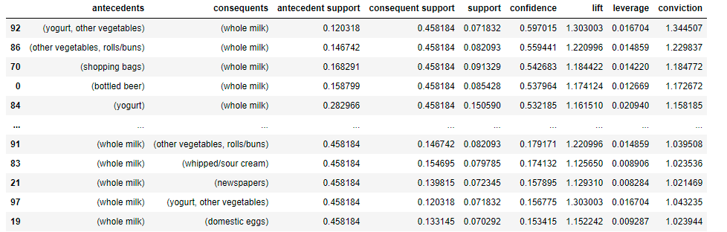
MODEL DEVELOPMENT & EVALUATION
A set of association rules is created to determine the optimal thresholds for support and confidence.
If min_support is set too low then the execution time will increase and will end up having a lot of rules (unnecessary).
Confidence to be used for sorting purposes and to find the most important relationships

Slide 10
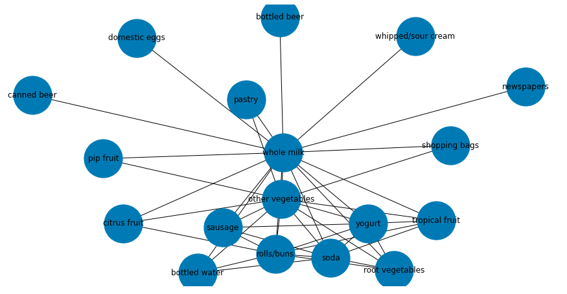
VISUALIZING THE ASSOCIATION
Whole Milk is the bestseller of this Grocery Store and has an association with the respective items.

Slide 11
CONCLUSION:
There are a couple of strategies that this Grocery Store can adopt to increase sales.
They need to reconsider the allocation of Whole Milk and its constituent partners.
Promotional discounts in either of the associated items can entice customers to buy Whole Milk.
Placing these items close to Whole Milk counter can be a good strategy to attract customers.

Slide 12
THANK YOU !!

